Slide 1
Facial Expression Recognition in Real Time
By:
Tarun Tanmay N049 Jai Verma N060
Kunal Kalyani N059

Slide 2
Contents
Problem Statement
Introduction
Project Demonstration
Video Demonstration
UI
DFD
Use Case Diagram and State Chart Diagram
Hardware and Software Requirements
Conclusion
Future Scope
References

Slide 3
Problem Statement
Our software aims to solve one of the biggest barriers between social robots and human communication – Facial Expressions. Human brains are made to convey and understand messages via body language and if robots cannot understand our body language or facial expressions, they will not be able to perform very well as companions or social partners.

Slide 4
Introduction
The project utilizes a 4-layer convolutional neural network and can be embedded in the decision-making software of any social robot such as NAO or Pepper. The model will decipher the user’s emotions and provide the result in text format to the final decision-making algorithm for the consumer software or AI.
It is not a functional software, but rather like an API or function which can be used in making other software especially in the field of AI and Robotics.

Slide 5
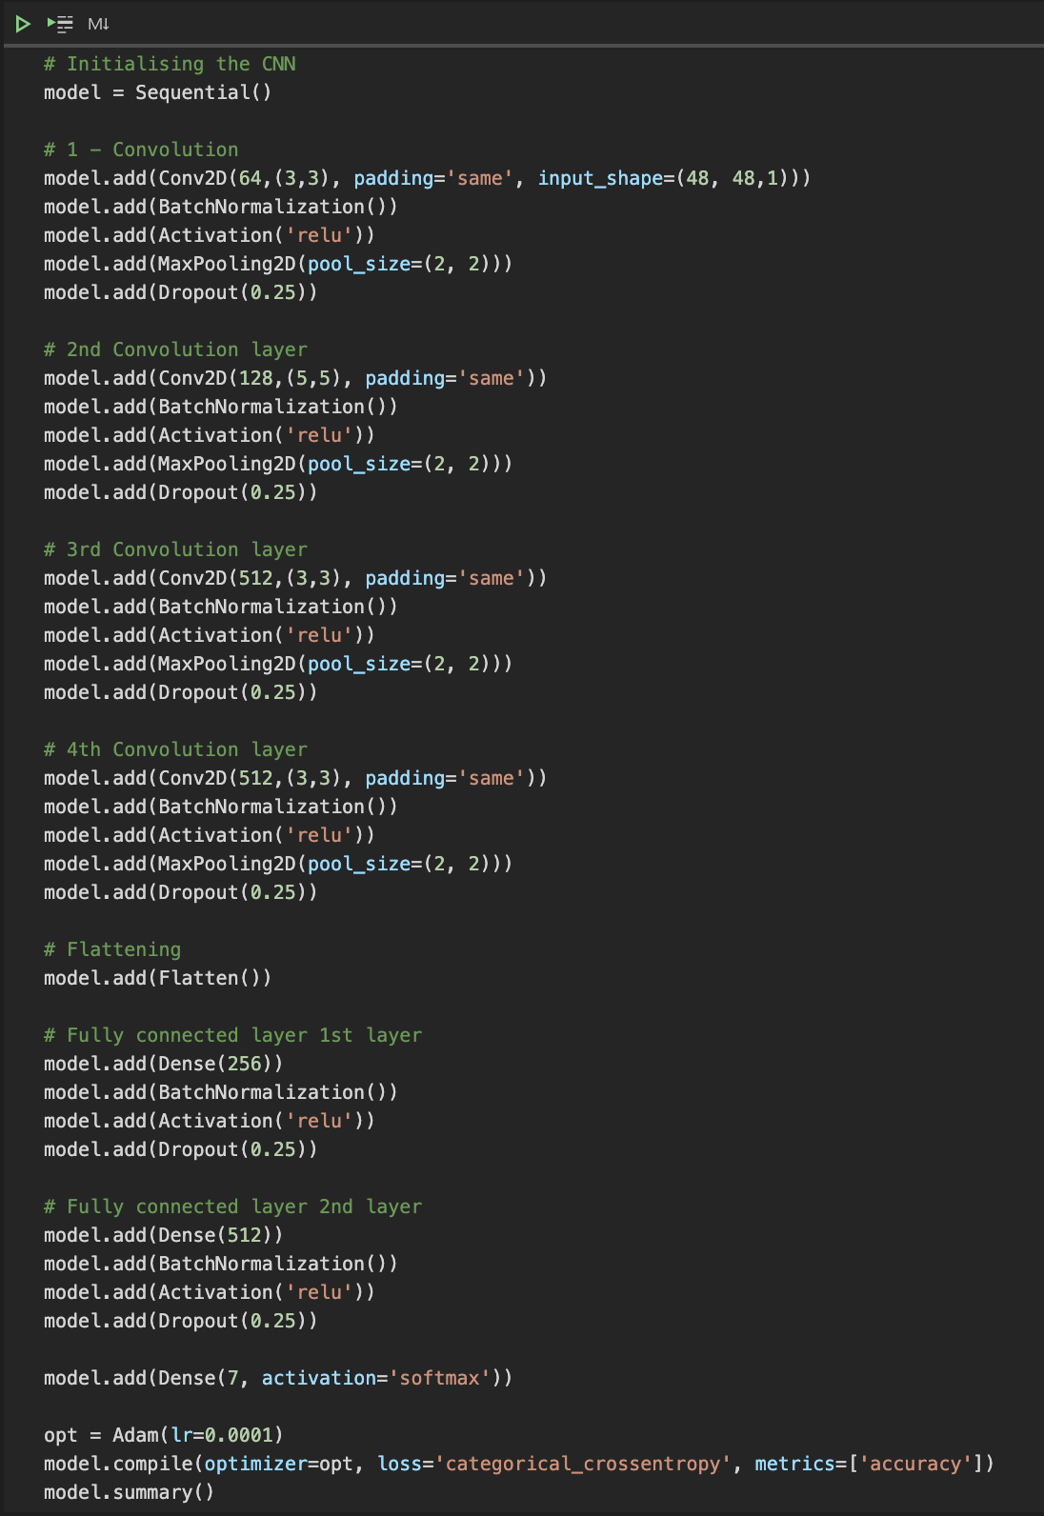
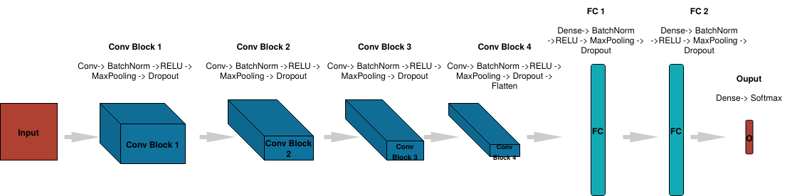
Proposed Model

Slide 6
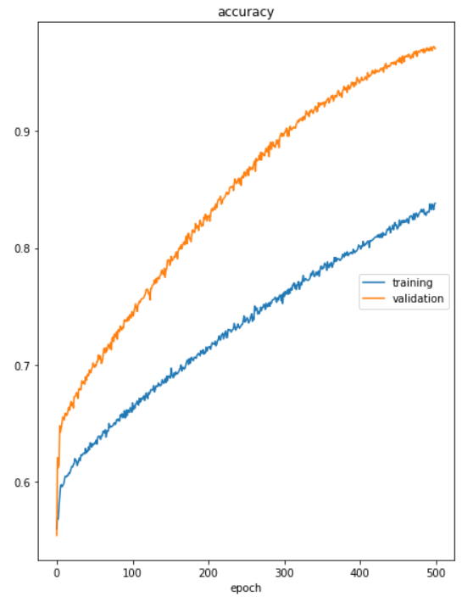
Accuracy Measure
Our convolutional neural network has achieved a validation accuracy of 97% which makes it great at recognizing human facial expressions even at a distance.

Slide 7

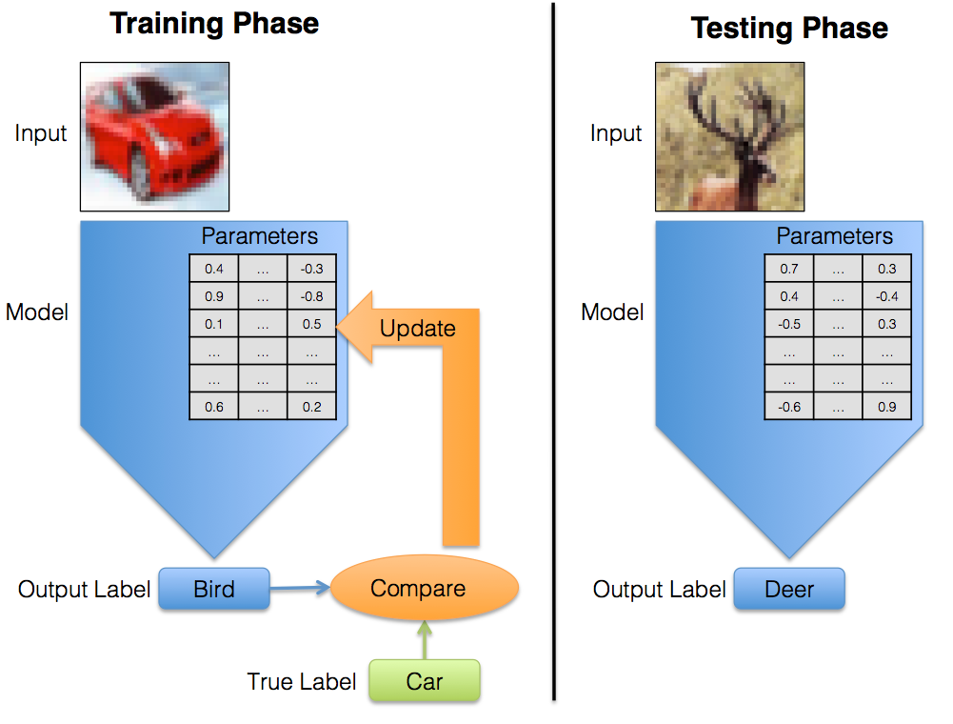
Training & Testing Phase
It works with the help of open-source libraries – TensorFlow, Keras, and OpenCV. All these python libraries help the project to perform exceptionally well when it comes to handling image recognition and facial expression extraction.

Slide 8
Project Demonstration
Open VS Code and explain Files:
Facial_Expression_Training.ipynb
Model.py
Camera.py
Main.py

Slide 9
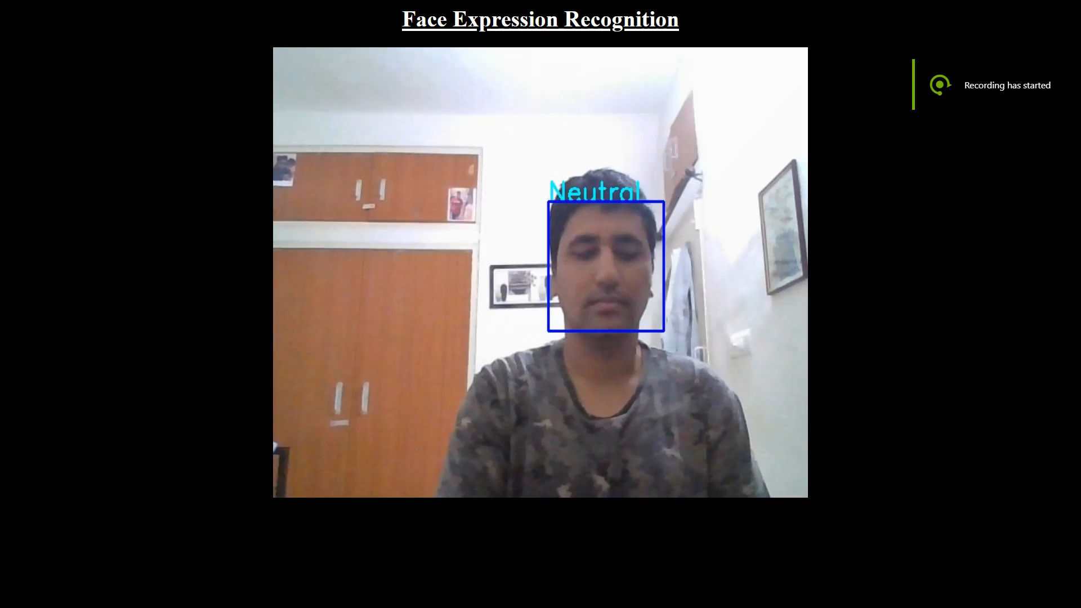
Video Demonstration

Slide 10
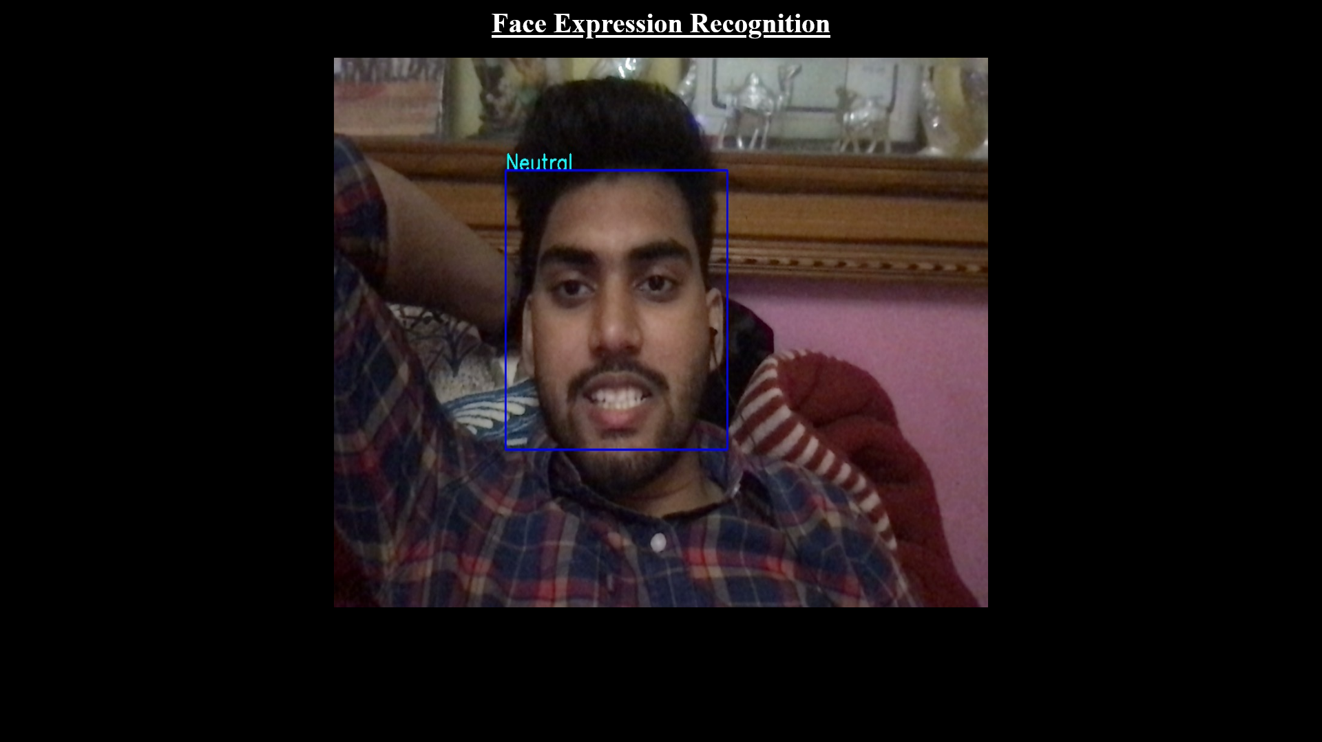
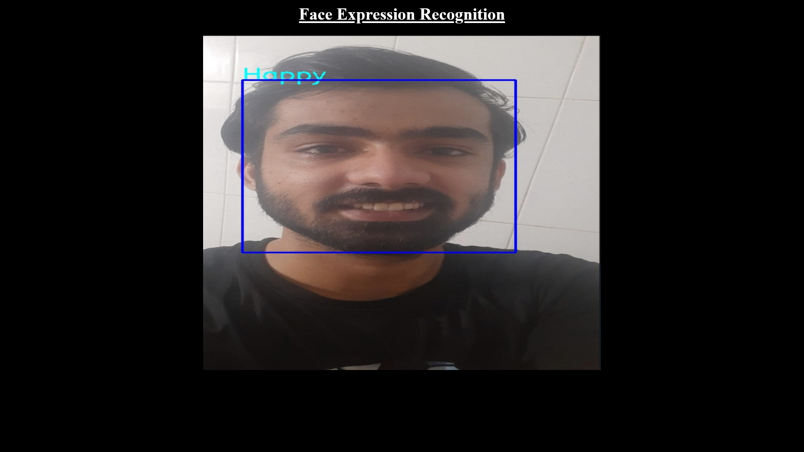
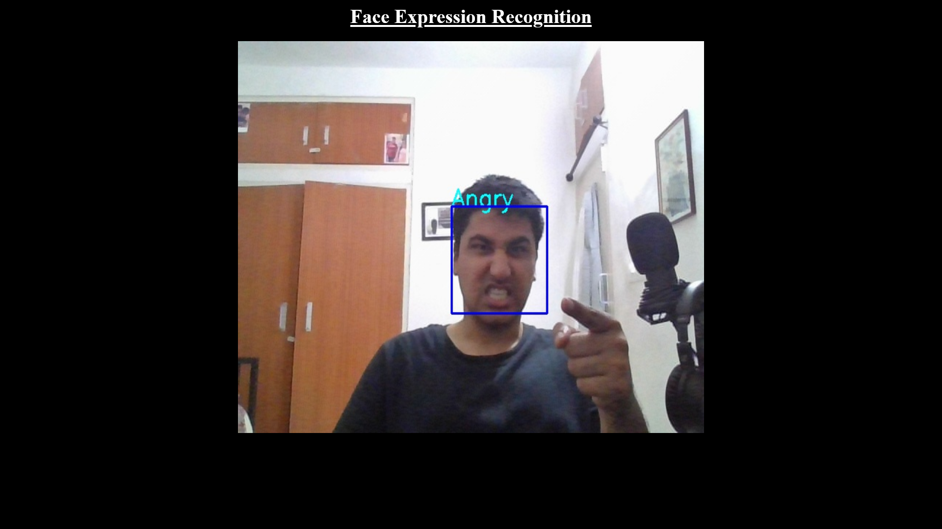
Expression Recognition

Slide 11
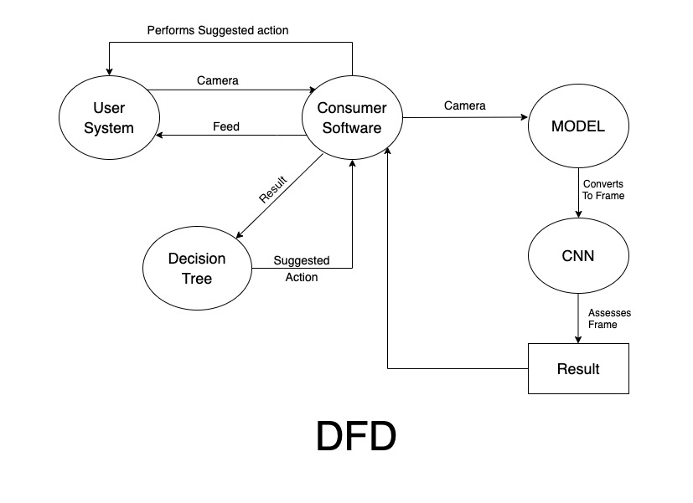
Data Flow Diagram

Slide 12
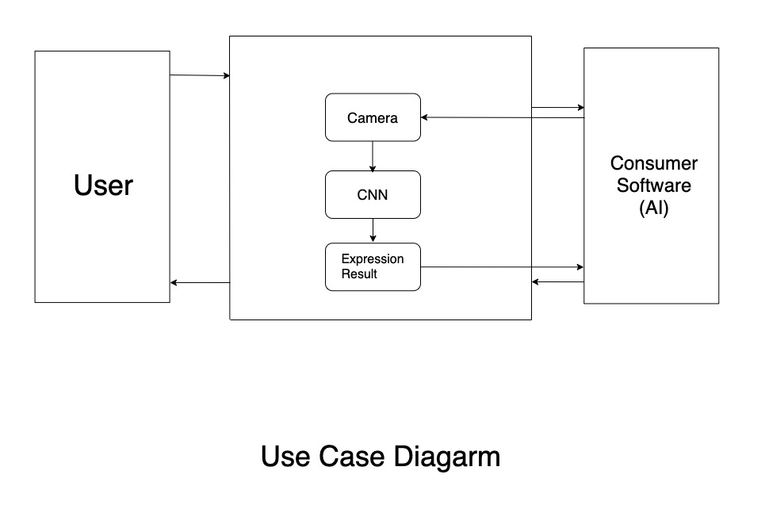
Use Case Diagram

Slide 13
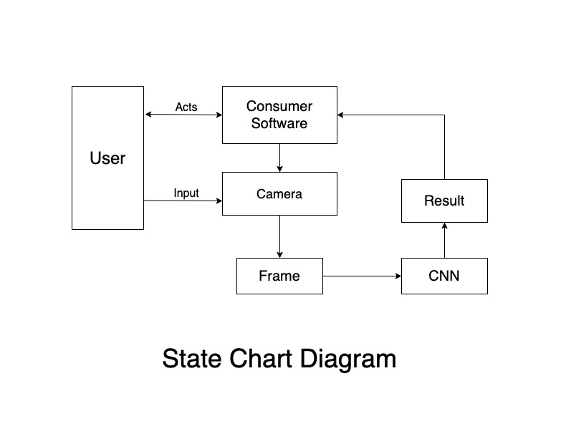
State Chart Diagram

Slide 14
Hardware and Software Requirements
User Interface.
Decision Making Algorithm.
Consumer-Level Software.
Hardware
Software
Functioning web camera or any video camera.
CPU with at least 4 cores.
At least 4 GB RAM.
Other Robot Hardware.

Slide 15
Conclusion
To conclude, our machine learning model can help bridge the gap between humans and robots. It can help make social and home companion robots feel more lifelike to their human users as they recognize their facial expressions during conversations and are able to use this information to make appropriate dialog.

Slide 16
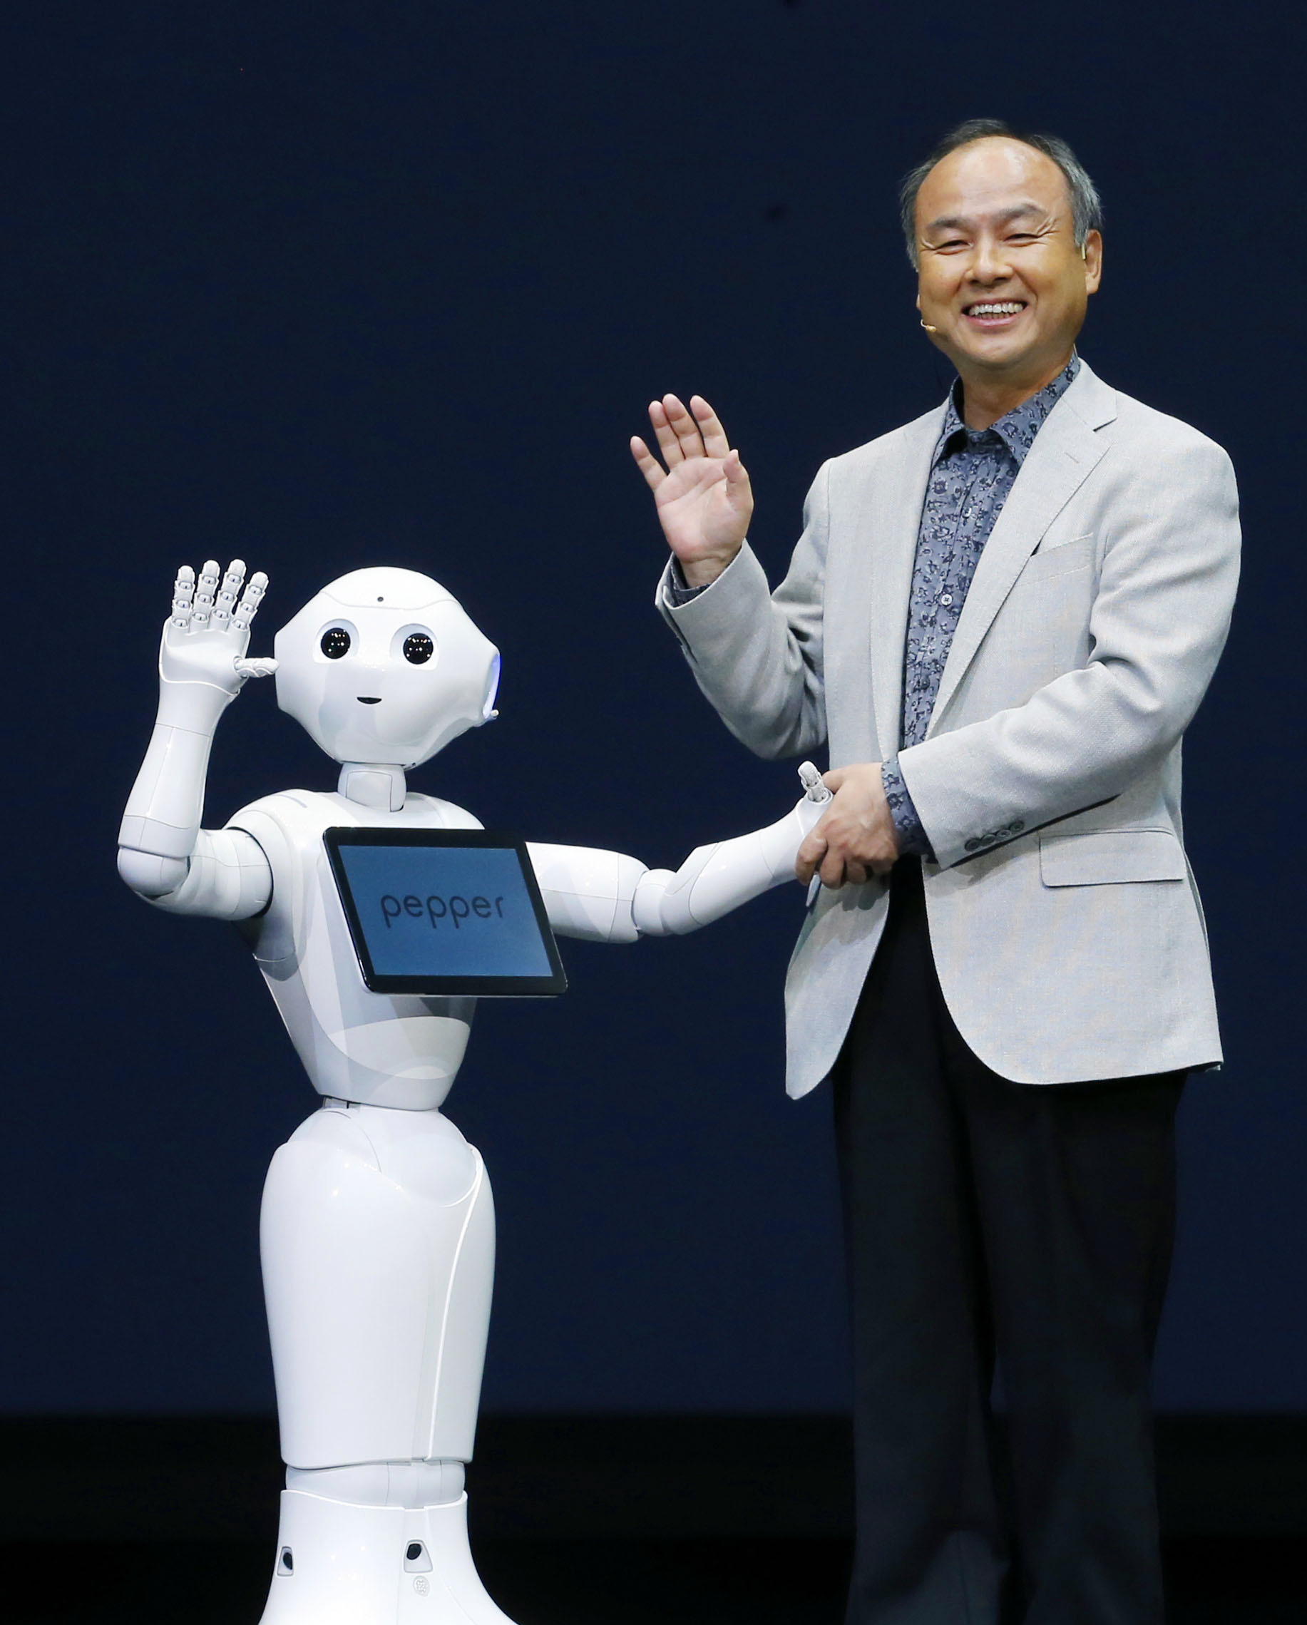
Future Scope
In the future, our machine learning model can be utilized to:-
Help in chatbot-based customer service.
Make companion robots feel more welcoming.
Help advance the computer science research in imprinting human emotions in machines.

Slide 17

References:
https://www.tensorflow.org/
https://opencv.org/
https://keras.io/
https://www.softbankrobotics.com/emea/en/nao
https://www.softbankrobotics.com/emea/en/pepper

Slide 18

Thank You

